Slide 1


Improving the Science and Practice of
Testing and Assessment
This material is not copyrighted. Copying and dissemination is encouraged.

Slide 2
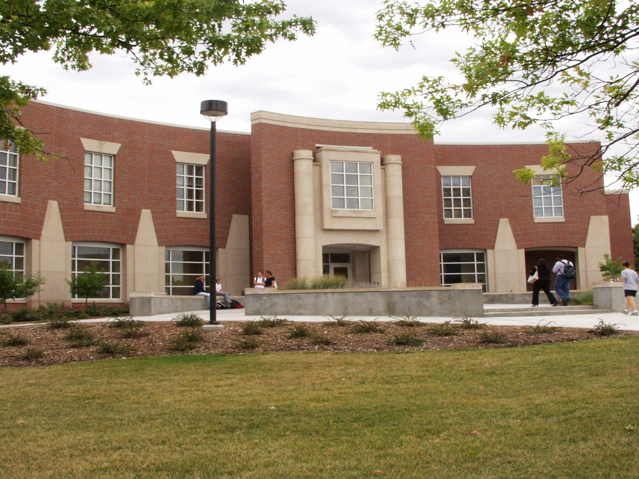
Today, the Buros Center comprises three complementary functions:
  test reviews & information
  psychometric consulting
  assessment literacy

Slide 3
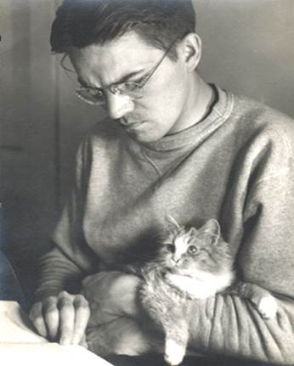
“Oscar Buros believed that it was incumbent upon the profession to monitor itself and he hoped that reviews of tests would spur improvements in test manuals, descriptions of the technical quality of tests, and test-related research that would [benefit] prospective test users.”
Oscar Krisen Buros
_______________________
Carlson, J. F., & Geisinger, K. F. (2012). Test reviewing at the Buros Center for Testing. International Journal of Testing, 12, 122-135.

Slide 4
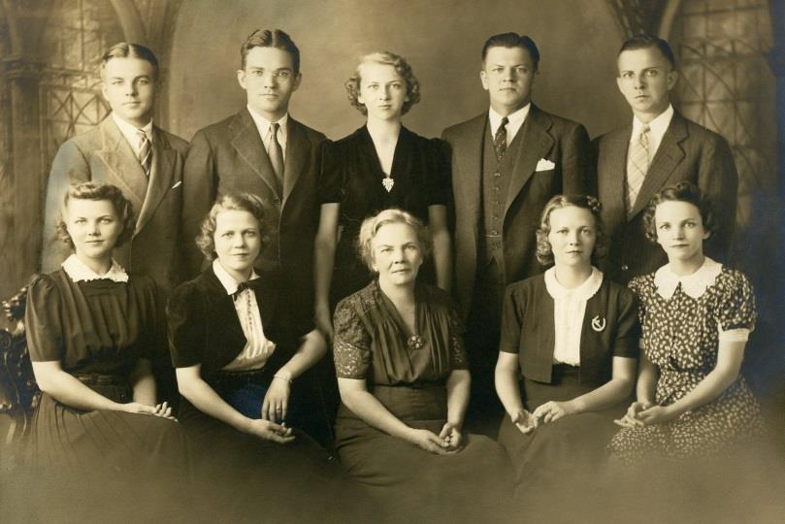
Oscar Buros (1905-1978)
Born in Wisconsin
B.S., University of Minnesota
M.A., Columbia University
Professor at Rutgers University from 1932 to 1975
Military service during WW II
Oscar Buros (c. 1922)

Slide 5
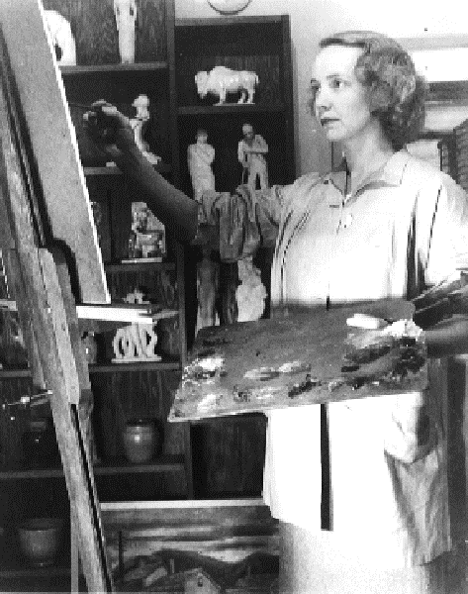
Luella Buros (1901-1995)
Educated at Columbia, Rutgers, and Ohio State University
Married Oscar Buros, December 1925
Book designer and artist
Activist for peace and social justice
Luella worked side by side with Oscar on the MMYs, earning recognition for her contributions.
Luella Gubrud Buros (c. 1940)

Slide 6
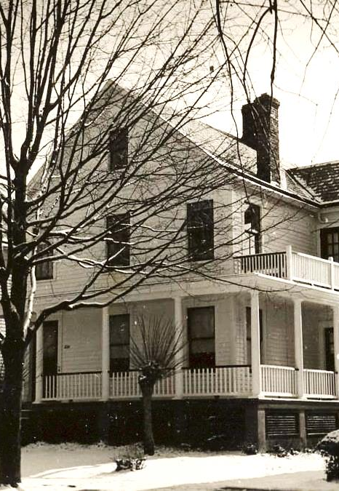
From 1938 until his death in 1978, Oscar (and Luella) Buros published eight MMYs.
Each MMY is a compendium of independent reviews of commercially available tests.
In 1941, they established The Gryphon Press and published under this imprint thereafter.
The house in New Jersey where Oscar and Luella Buros lived with their cats on the second floor, rented out the first, and produced the MMYs in the basement.

Slide 7
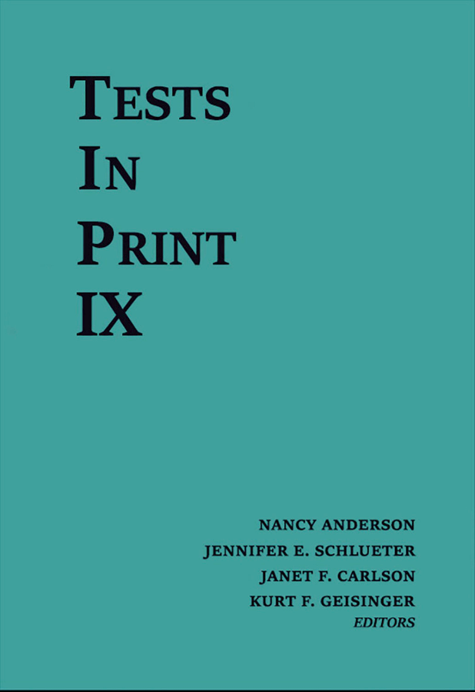
Tests in Print
Oscar Buros recognized the need for a second reference series that lists and provides vital information about all tests currently on the market.
In 1961, he published the first volume of Tests in Print (TIP), which also served as an index to MMY reviews.
TIP IX was published in 2016 and TIP X is in development.

Slide 8
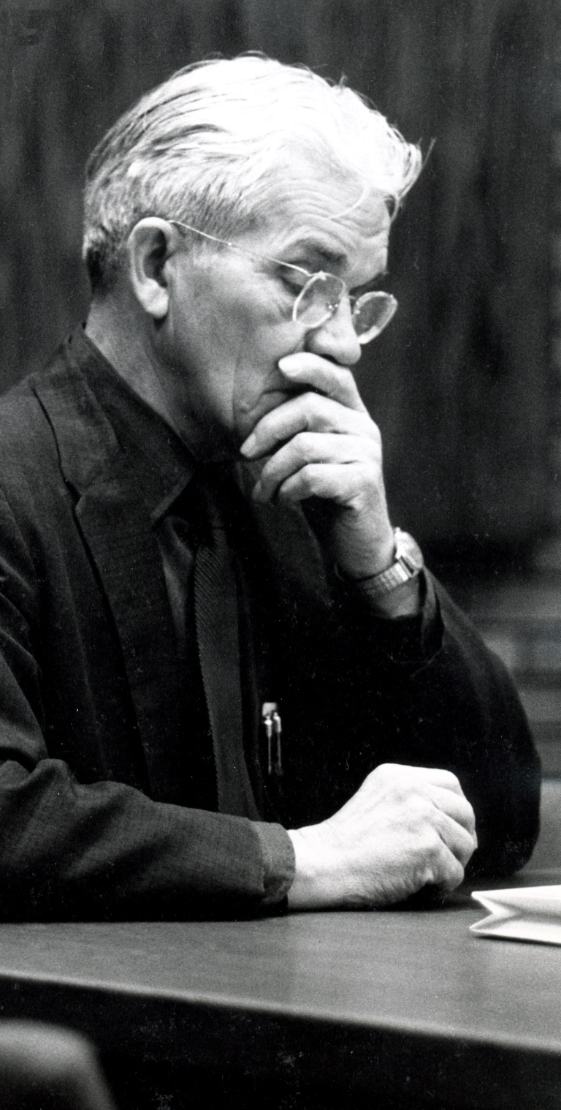
“Oscar Buros has not only created, single-handed, an important institution in the field of educational and psychological measurement; he is the institution. . . . The weakness of the one-man show is bound up in the simple and uncomfortable question: What happens to the institution when Buros retires?”
________________________________
Dyer, H. S. (1968). [Review of the book The Sixth Mental Measurements Yearbook, edited by Oscar K. Buros]. American Educational Research Journal, 5, 109-113.

Slide 9
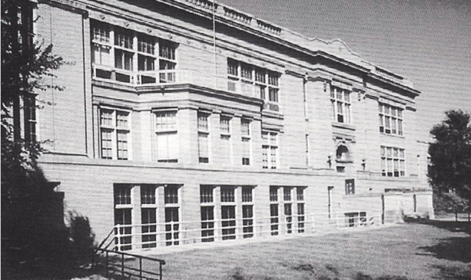
Ensuring Oscar’s Legacy
Luella ensured Oscar’s work would continue.
First, she completed the 8th MMY. Then, she sought a new home for the Institute of Mental Measurements.
Ultimately, she transferred the Institute’s considerable holdings to UNL; it was the university’s first major research center.
Bancroft Hall at the University of Nebraska – Lincoln was the second home of the Buros Institute of Mental Measurements.

Slide 10

The Mental Measurements Yearbook
The first yearbook published at UNL was The Ninth Mental Measurements Yearbook (1985).
Gary Anderson
10th MMY
11th MMY
12th MMY
13th MMY
14th MMY
15th MMY
1989
1992
1995
1998
2001
2003
16th MMY
17th MMY
18th MMY
19th MMY
20th MMY
21st MMY
2005
2007
2010
2014
2017
2021

Slide 11
Mental Measurements Categoriesª
Behavior Assessment (16.7%)
Personality (15.1%)
English & Language (15.1%)
Vocations (9.4%)
Neuropsychological (8.9%)
Miscellaneous (6.8%)
Intelligence & General Aptitude (6.8%)
Developmental (5.2%)
Speech & Hearing (4.2%)
Reading (3.6%)
Education (2.6%)
Achievement (2.1%)
Sensory Motor (2.1%)
Mathematics (1.6%)
Science (0.0%)
Foreign Languages (0.0%)
Fine Arts (0.0%)
Social Studies (0.0%)
ª Percentages reflect proportions in The Twenty-First Mental Measurements Yearbook

Slide 12
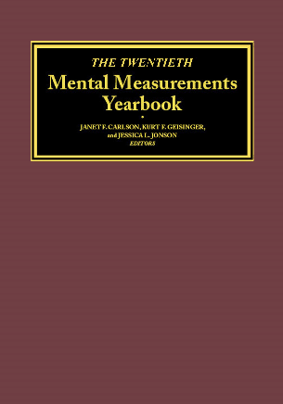

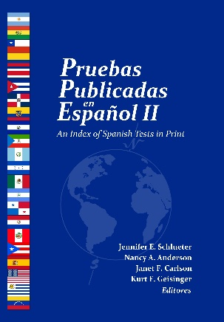
Reference Book Series
The Buros reference books are renowned as authoritative sources for essential information about tests.
MMYs have been called the Consumer Reports of the testing industry.
Latest editions
Tests in Print IX (2016)
The Twenty-First Mental Measurements Yearbook (2021)
Pruebas Publicadas en Español II (2018)
Forthcoming
Tests in Print X (2021)
Pruebas Publicadas en Español III (2023)

Slide 13
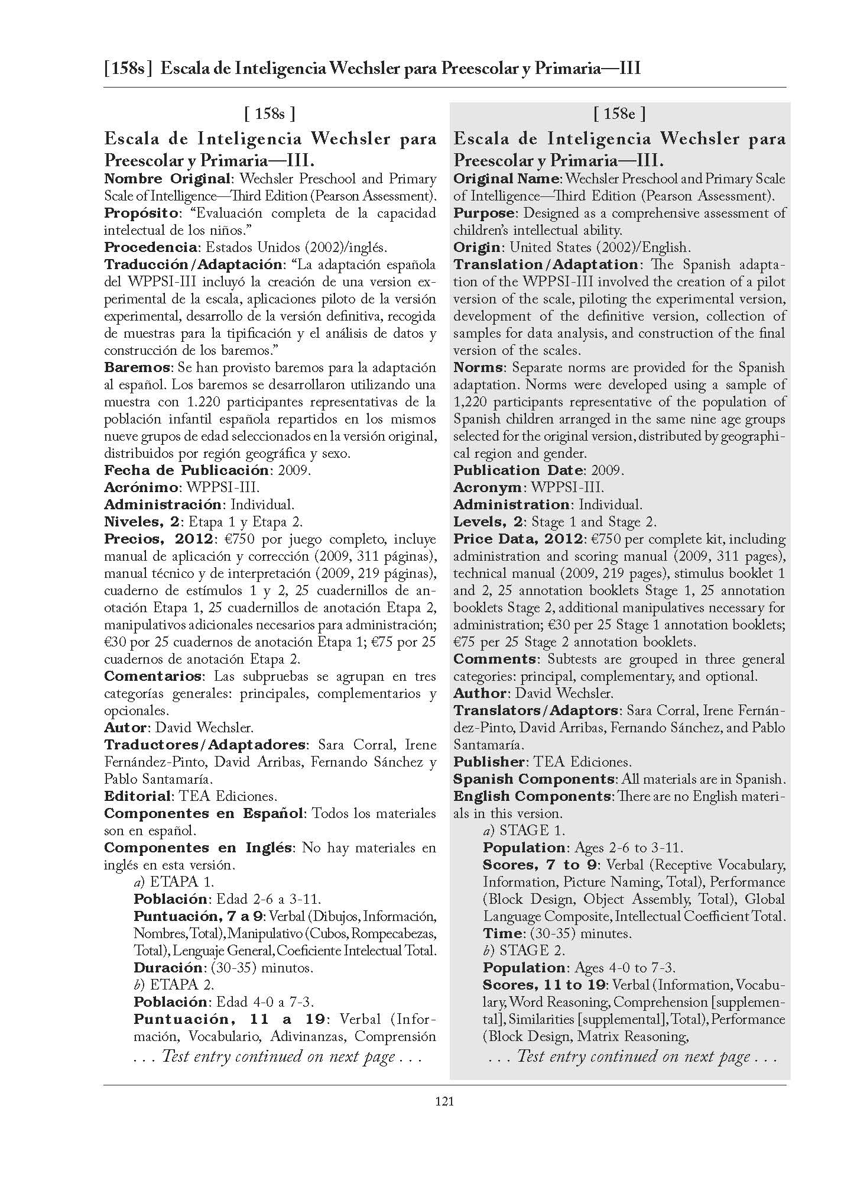
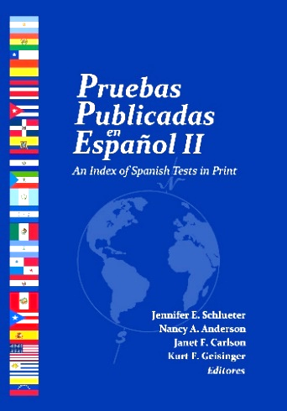
Pruebas Publicadas en Español: An Index of Spanish Tests in Print (PPE)
First edition in 2013
Spanish equivalent of TIP
Includes unique fields (e.g., norms, country of origin, adaptation)
Information presented side by side in Spanish and English.

Slide 14


Electronic Access
All content from our reference books series is available via database subscriptions offered by EBSCO and Ovid.
Buros also offers a search engine and digital resources on UNL Marketplace, where visitors may purchase individual reviews and digital PPE.

Slide 15
Psychometric Consulting
Established in 1994, when the Buros Institute became the Buros Center for Testing
Focuses on propriety testing programs
  Tests with moderate to high stakes
  For example, educational assessment, licensure, certification, admissions, and employment
Works to improve the quality of testing programs and validity of test results

Slide 16

Psychometric Consulting
Psychometric Consultation
    Technical assistance for psychometric aspects of testing programs and data analyses
Evaluation and Oversight
    Conduct needs and gap analyses; replicate and/or verify scoring, equating, linking; evaluate contract compliance; serve as a third-party monitor of testing operations
Professional Development and Training
    Provide item writing and test construction workshops
Audit and Accreditation
    Evaluate processes and procedures (Stage One)
    Evaluate specific tests used (Stage Two)

Slide 17





Psychometric Consulting
State Departments of Education
Florida
Hawaii
Michigan
Nebraska
South Dakota

Slide 18










Psychometric Consulting
Other Clients
Society of Human Resource Management
Saudi Arabia
Council for Aid to Education
Federation of State Boards of Physical Therapy
ELS Educational Services

Slide 19
Assessment Literacy
Launched in 2011 to further extend the Center’s mission.
Educates test authors, publishers, and users about sound measurement practices.
Resources enhance the ability of individuals to develop and use assessments in accordance with professional standards and accepted guidelines for responsible test use.

Slide 20
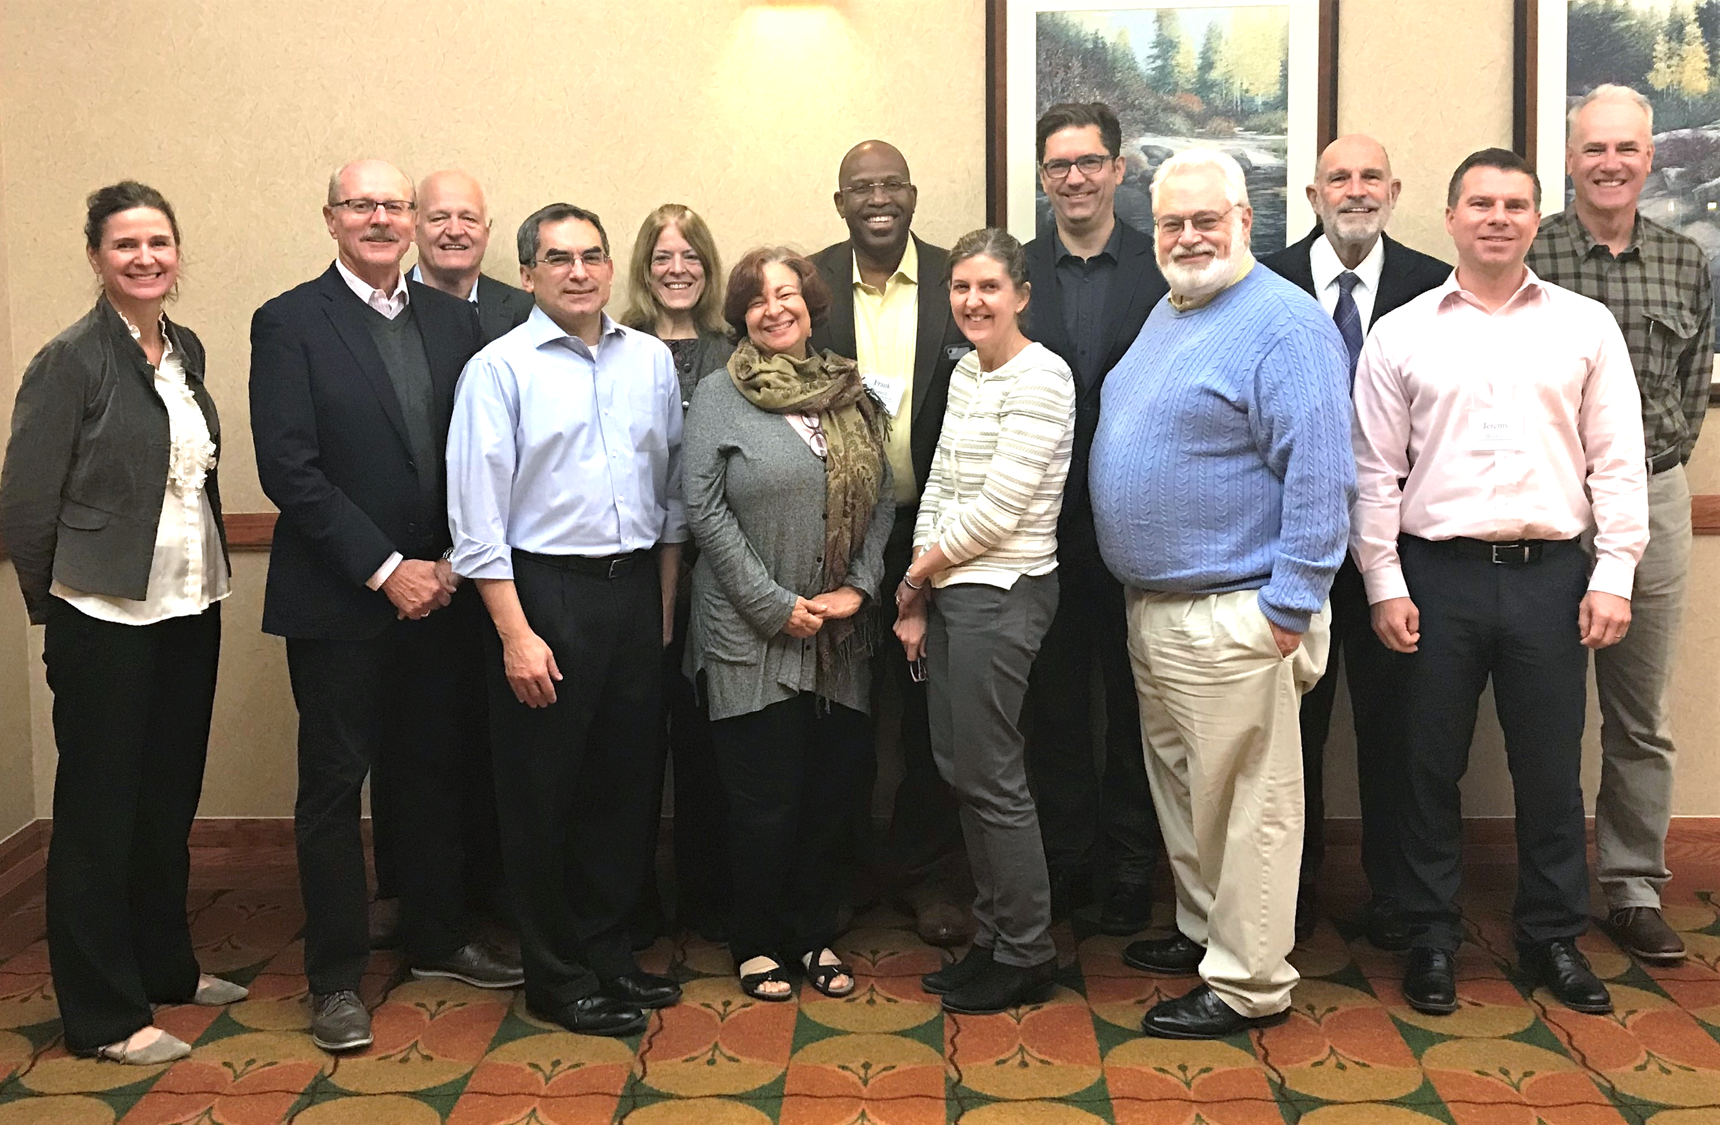
Assessment Literacy
Primary Audiences
School Psychologists
(NASP Continuing Professional Development Provider)
Educators
(State Dept of Education, University Faculty)
Clinical/Counseling Psychologists
(APA Continuing Education Provider)
Test Developers
(ACT, Pearson, College Board)
Graduate Students

Slide 21
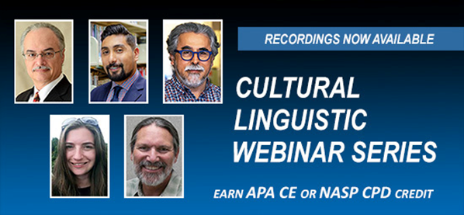
Assessment Literacy
Products and Services
Conferences/Webinar Series
Three conferences
Seven webinar series of 5-6 presentations
Video Library
Webinars, conferences, lectures
Most offered as continuing education
No charge for selected videos
Used by faculty to enrich course content
Licensing of Video Content
ProQuest – video database collections
ACT – Professional staff development

Slide 22
Assessment Literacy
Grants
AERA Research Conference Grant
Fairness in Testing
  OUTCOME: AERA Accepted Book Proposal
Spencer Foundation Conference Grant
  Psychometric Guidelines for Social-Emotional Learning Assessments
  OUTCOME: SEL Assessment Technical
  Guidebook, which you can download at buros.org/assessment

Slide 23

Buros Library
Special reference library
Housed at UNL for 40 years
Collections include
  8,500 educational and psychological tests
  1,800 books on testing and measurement
  650 books from Oscar’s library
  original works of art by Luella Buros

Slide 24
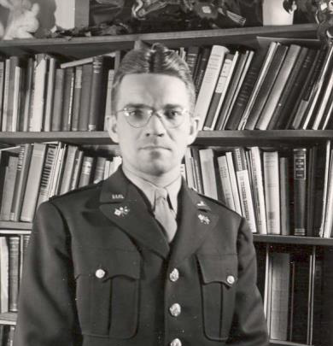
  The Library is staffed by a librarian (graduate assistant) about 25 hours per week during the fall and spring semesters.
Librarian assistance is needed to access all test materials and books in the secure collections.
Oscar Buros in WWII

Slide 25
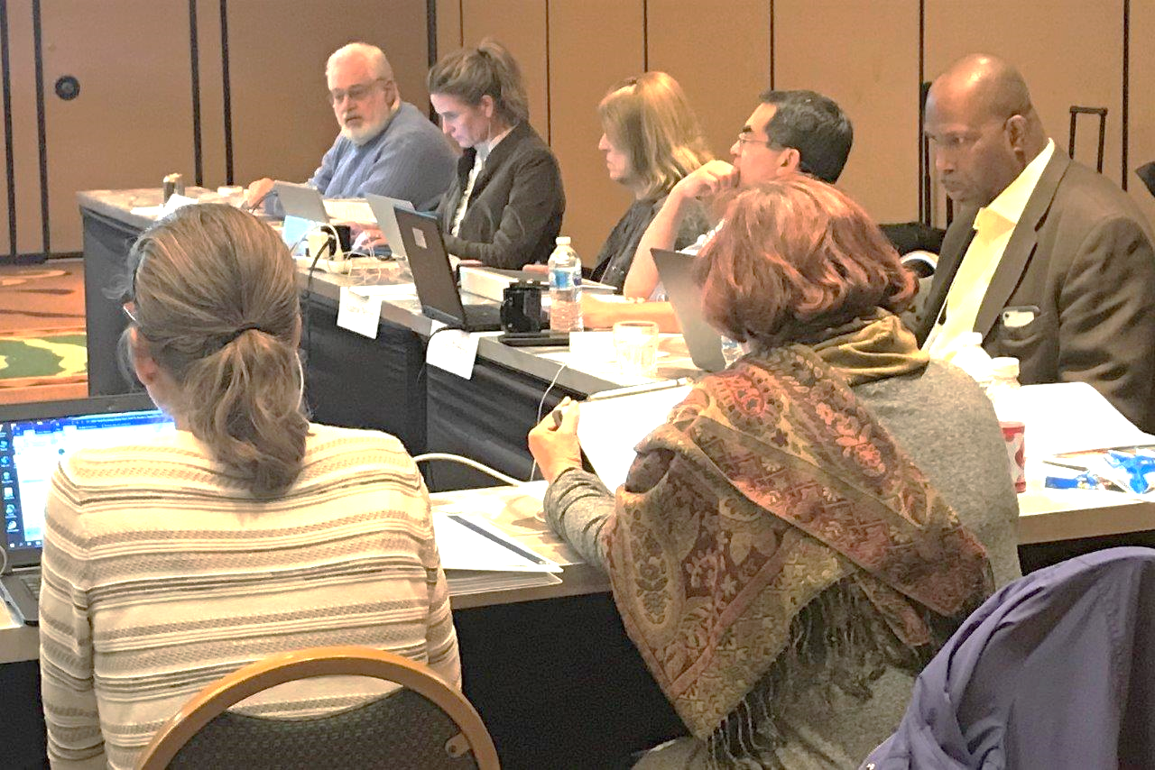
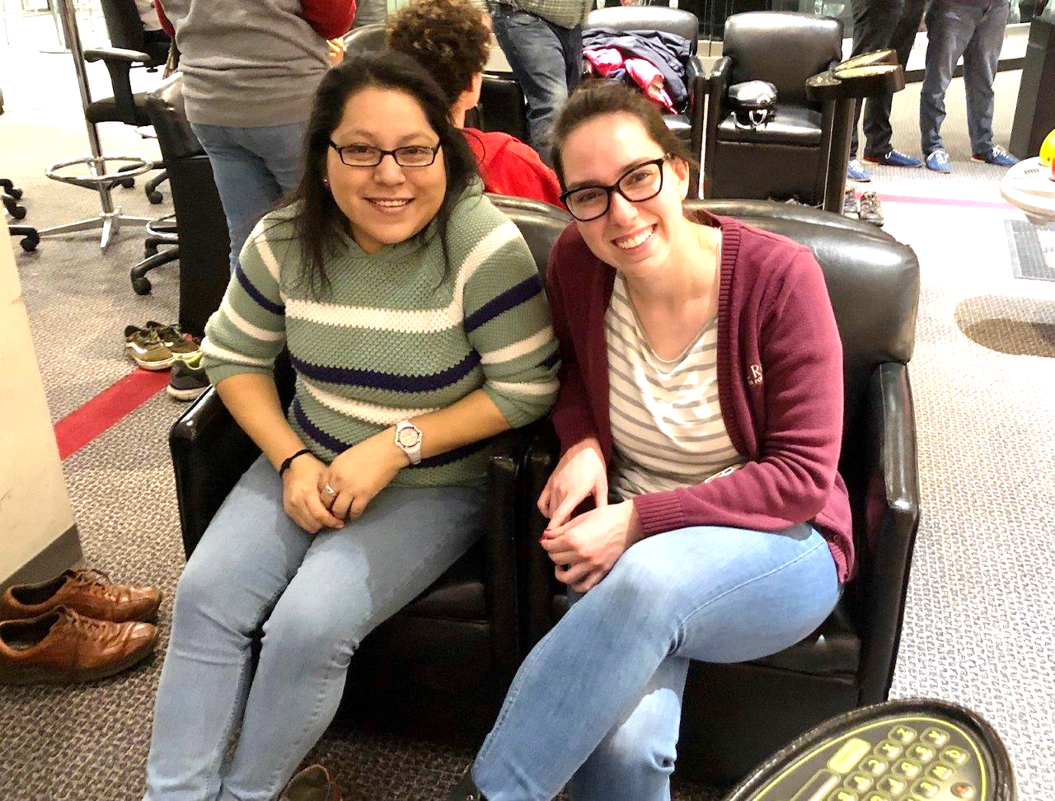

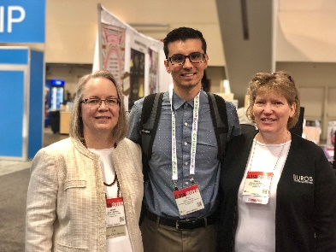
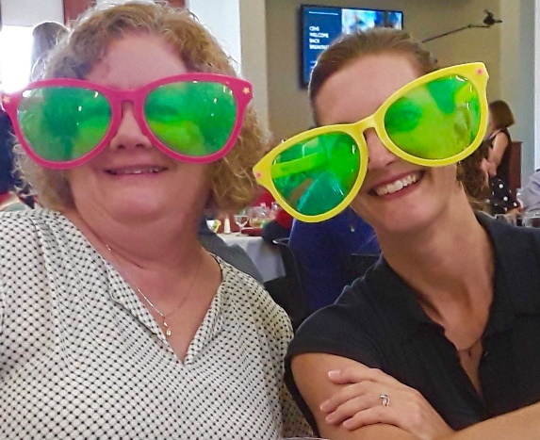
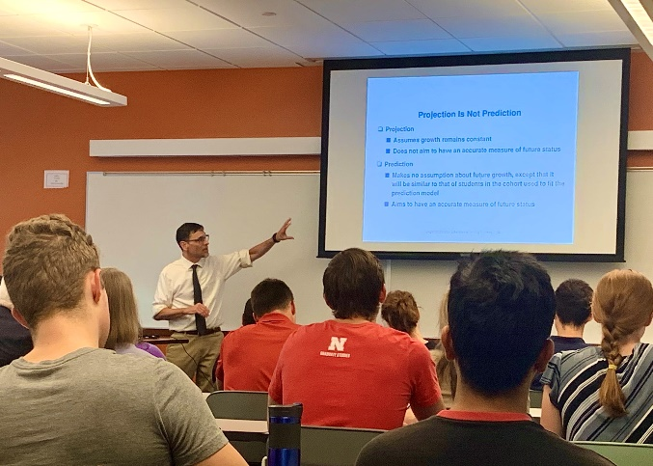
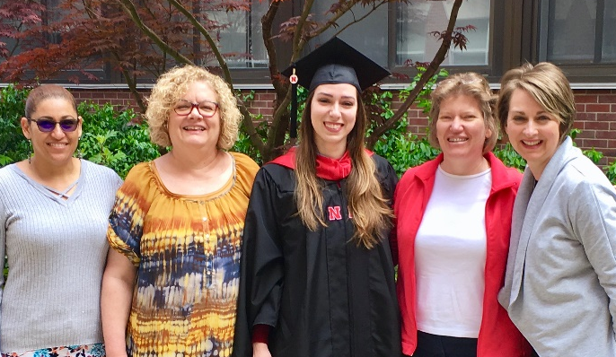
Thanks for visiting! Learn more about the Buros Center for Testing at buros.org and connect with us online on LinkedIn.

